Slide 1
Propel 5 + 2
UMKC Faculty Senate 16 October 2018
Alexis Petri, EdD
petria@umkc.edu
816.235.5872

Slide 2
Nationally, Propel is first to focus on urban, students of color
Propel demographics average 66-70% students of color; 65% male; 60% urban; 100% have I/DD
1/2016
Bridge to College starts with 22 students; serves 20-24 students each year.
8/2016
Propel hires 10 mentors
8/2017
Propel hires 10 mentors
Summer 2018
14 Propel students serve as Summer VISTAs
8/2018
Propel hires 10 mentors
Propel is an engine of student and community engagement
8/2016
Propel cohort 1 = 15
8/2017
Propel cohort 2 = 20
8/2018
Propel cohort 3 = 18
Per year:
20 SL students; 10 mentors; 2 grad students; 2 VISTAs; 10-12 peer mentors; 50 community partners
7/2016
Propel officially a 2-year certificate program
5/2018
10 members of Propel cohort 1 graduate and have completed 480 credit hours
9/30/2015
Propel funded by U.S. Dept of Ed
5 years; $1.8 million
Propel: 2 year inclusive postsecondary program; students pay tuition and fees; earn 48 credit hours; participate in 4 service-learning/internship courses; take regular UMKC courses 60-70% of the time

Slide 3
Nationally, Propel is first to focus on urban, students of color
Propel demographics average 66-70% students of color; 65% male; 60% urban; 100% have I/DD
1/2016
Bridge to College starts with 22 students; serves 20-24 students each year.
8/2016
Propel hires 10 mentors
8/2017
Propel hires 10 mentors
Summer 2018
14 Propel students serve as Summer VISTAs
8/2018
Propel hires 10 mentors
Propel would not be possible without the UMKC students, faculty, staff, and administrators who share their time and talent, instruct and guide, and welcome Propel students to campus.
Propel is an engine of student and community engagement
8/2016
Propel cohort 1 = 15
8/2017
Propel cohort 2 = 20
8/2018
Propel cohort 3 = 18
Per year:
20 SL students; 10 mentors; 2 grad students; 2 VISTAs; 10-12 peer mentors; 50 community partners
7/2016
Propel officially a 2-year certificate program
5/2018
10 members of Propel cohort 1 graduate and have completed 480 credit hours
9/30/2015
Propel funded by U.S. Dept of Ed
5 years; $1.8 million
Propel: 2 year inclusive postsecondary program; students pay tuition and fees; earn 48 credit hours; participate in 4 service-learning/internship courses; take regular UMKC courses 60-70% of the time

Slide 4
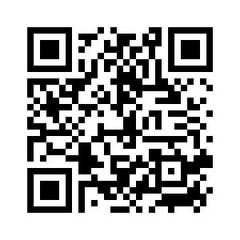
Nationally, Propel is first to focus on urban, students of color
Propel demographics average 66-70% students of color; 65% male; 60% urban; 100% have I/DD
Resources for Faculty:
https://info.umkc.edu/propel/faculty-support-portal/
Password: Include
Interested in universal design for learning? Contact me – petria@umkc.edu
1/2016
Bridge to College starts with 22 students; serves 20-24 students each year.
8/2016
Propel hires 10 mentors
8/2017
Propel hires 10 mentors
Summer 2018
14 Propel students serve as Summer VISTAs
8/2018
Propel hires 10 mentors
Propel is an engine of student and community engagement
8/2016
Propel cohort 1 = 15
8/2017
Propel cohort 2 = 20
8/2018
Propel cohort 3 = 18
Per year:
20 SL students; 10 mentors; 2 grad students; 2 VISTAs; 10-12 peer mentors; 50 community partners
7/2016
Propel officially a 2-year certificate program
5/2018
10 members of Propel cohort 1 graduate and have completed 480 credit hours
9/30/2015
Propel funded by U.S. Dept of Ed
5 years; $1.8 million
Propel: 2 year inclusive postsecondary program; students pay tuition and fees; earn 48 credit hours; participate in 4 service-learning/internship courses; take regular UMKC courses 60-70% of the time

Slide 5
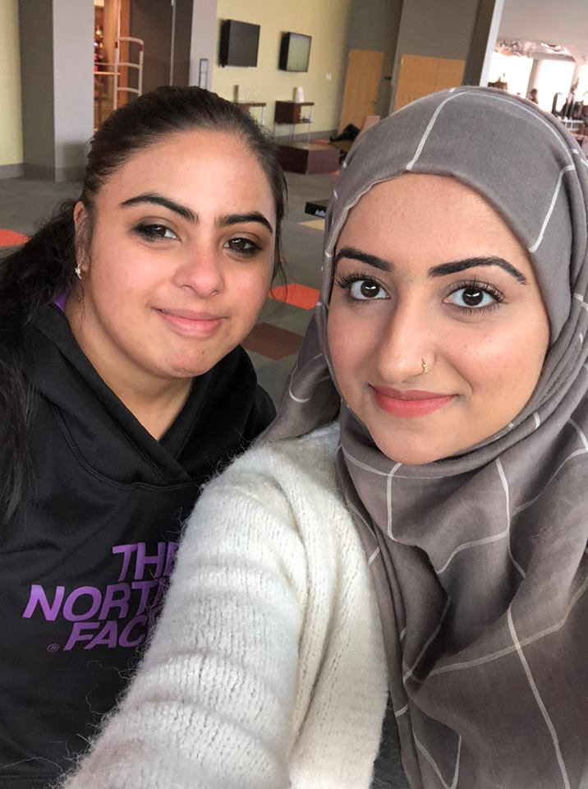
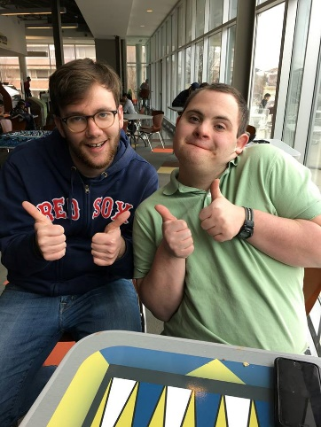
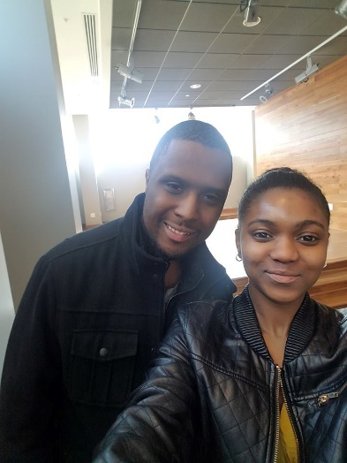
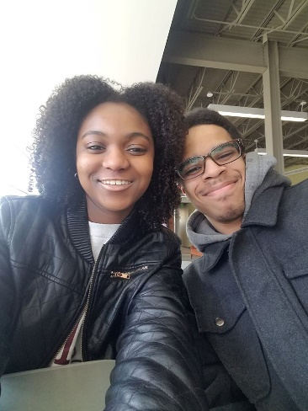
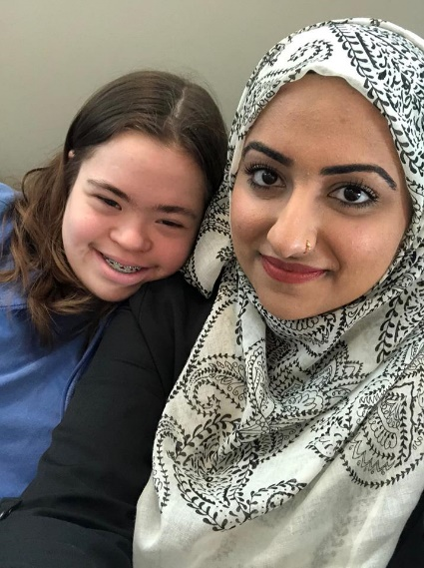
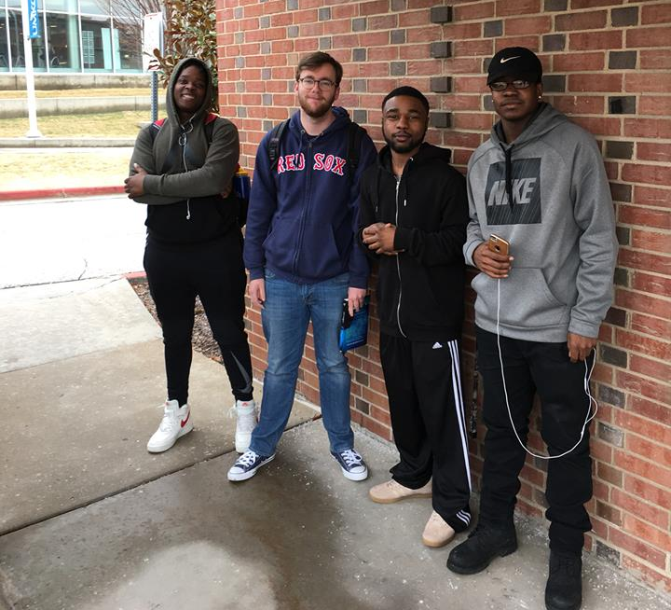
2 Requests
Invite Propel to a department meeting or a class to talk about inclusive higher education – what is it and why does it matter?
Consider hosting a Propel student to volunteer in your department 2 hours per week.

